Slide 1





MUKESH BABU
CENTRE HEAD
MG-CEIT-FIJI

Slide 2
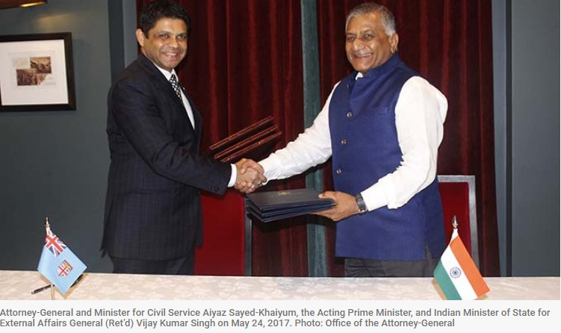
Introduction (CEIT)
A Joint collaboration project of Government of India and Government of Fiji as per MoU signed on 24 May 2017.
Mahatma Gandhi Centre of Excellence in Information Technology, Fiji

Slide 3
Introduction (MG-CEIT)
CEIT main objective is to provide advanced technology training to IT professionals from different sectors: business, public and academic.
This specialized centre consist of two properly equipped laboratories. The labs will be installed with different programming languages such as JAVA, and .NET as well as ORACLE and SQL server databases.
Student to receive subsidized training on in-demand skills with an International Certification from C-DAC (on successful completion of courses) that will make them job ready. We have completed this project on Africa.

Slide 4
Centre will be hub among pacific island countries for tele-medicines and tele-education network
Strengthening India-Fiji Human Resource Development cooperation by giving 6 months training to six participants from Fiji in C-DAC Pune India.
Two master trainer Mr. Eremasi Tamanisau and Mr. Jonasa Rinakama have attended advanced IT training from CDAC India for the first batch from Fiji.
Mr Ulaiasi Vukinawasawasa & Mr Suka Buadromo will be taking 6-month IT training from 19.2.19-7.8.19 at C-DAC, Pune, India for the second batch from Fiji.

Slide 5


Slide 6

FIJI-INDIA CEIT Courses
S# | Course | Total Course Duration (In Hours) | Exit Profile
1 | Advanced Web Technology | 320 | Website Designer
2 | Java Programing | 320 | Java Application Developer
3 | Database Management | 320 | Database Administrator
4 | Linux System Administration | 320 | Linux Administrator
5 | iPhone Programming | 320 | iPhone developer
6 | Android Programming | 320 | Android Developer
7 | Business Computing | 320 | Software Analyst
8 | Network & Cyber Security | 320 | Cyber Security Specialist
9 | Software Testing | 320 | Software Tester
Mahatma Gandhi Centre of Excellence in Information Technology, Fiji

Slide 7
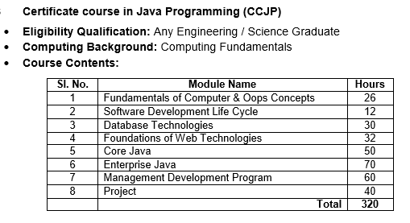
FIJI-INDIA CEIT Courses
Mahatma Gandhi Centre of Excellence in Information Technology, Fiji

Slide 8
Certificate Course in Java Programming (CCJP)
Certificate Course Java Programming aims to groom the students to enable them to work on current technology scenarios as well as prepare them to keep pace with the changing face of technology and the requirements of the growing IT industry. Java is one of the most popular languages in the IT industry and many existing/upcoming technologies like android, Hadoop, node-red, angular js uses java framework, which java assures demand for java professional in IT market in coming future.
After the completion of the course, students can work as Software Developer or Programmer /IT Support staff/ Trainee / Tester / Technical Support and associated service sectors
Total Duration - 320
Contact hours -120
Self Directive learning -180
Project - 40

Slide 9
Fundamentals of Computer & OOPs Concepts -(26 Hours)
Fundamentals of Computers, Uses of Computer, Hardware, Accessories, Interfaces and their functions, Computer hardware connectivity
Primary and Secondary storage, Input-output devices, Software, types of software.
Operating System (Introduction, The Need of Operating System, Functions of Operating System User Interface), Integer representation and number conversion, Linux Commands, Fundamentals of Algorithms Systems, Software
Mathematical Analysis for recursive and non recursive algorithm, Object Oriented concepts, Classes and Objects, Access Specifiers, Overloading, Inheritance, Polymorphism used in Academic departments and other area.

Slide 10
Software Development Life Cycle (12 Hours)
Software Engineering, Brief concept of Software Life Cycle Models
Agile Techniques for software development
Software Development Tools & Techniques
Introduction to Coding Standards, Software Testing
Database Technologies (30 Hours)
Database Concepts, Client/Server Computing, RDBMS Technologies, Codd’s Rules
Data Models, Normalization Techniques, ER Diagrams
SQL and PL/SQL/ Overview of RDBMS
Introduction SQL*Plus
DDL, DML and DCL
Tables, Indexes and Views, Generic PL/SQL

Slide 11
Foundations of Web Technologies (32 Hours)
HTML 5.0 programming, Overview of Internet and Web Pages, Introduction to HTML Tags, Introduction to Web Browser / Composer, Introduction to HTML Editor
CSS Introduction, CSS Syntax, CSS Id & Class, CSS How To, CSS Styling, CSS Box Model ,CSS Summary
Java Scripting, JS Introduction, JS Statements, JS Comments, JS Variables, JS Operators, JS Comparisons,JS Popup Boxes, JS Functions, JS Events, JS Special Text, JS Objects,JS RegExp
Energizing pages with animations and effects
DOM with jQuery utility functions
The Purpose and Nature of XML, XML Document Type Declaration, XML and Data Binding XML linking mechanisms
XML style language, XML parsers

Slide 12
Core Java (50 Hours)
Data Types,Operators,Constructors
Inner Classes and Inheritance.
Interface and Package
Exceptions
Threads
Java.lang
Java.util
Java.awt
Java.io
Collections

Slide 13
Enterprise Java (70 Hours)
Servlets, Java Server Pages
Remote Method Invocation
JDBC
JavaBeans, Enterprise Java Beans
Java Security, Naming Services,
Java Mail, Java Messaging Services
Transactions.
Spring and Hibernate Framework.
Introduction to Soap and Rest web services.
Introduction to JSF

Slide 14
Management Development Program (MDP) (40 Hours)
Introduction to communication
Barriers to communication, Kind of communication
Confidence building, Non-verbal Communication
Synonyms/Antonyms /Fluency and vocabulary
Grammar, Noun Pronoun, Verb, Adjective, Preposition, Conjunction, Words of Idioms & phrases, Sentence Construction, Fill up the blanks, Pronunciation, Conversation
Polite Conversation, Greeting, Logical reasoning, General Aptitude
Writing:Covering letter, Resume, Email, Presentation Skill, group discussion, Interview skills, Mock interview

Slide 15
Project (40 hours)
Project will be given to the group of students to develop the program / application
Total Duration - 320
Contact hours -120
Self Directive learning -180
Project - 40

Slide 16
MG-CEIT Process
Registration through Facebook page ceitfiji
Attendance of each Modules
Conduct exam of each modules
Participant Feedback Form at the end of course
Certificate form CDAC

Slide 17




